Slide 1

Data Analysis for Credit Card Fraud Detection Alejandro Correa Bahnsen Luxembourg University

Slide 2
Introduction

Slide 3
Introduction

Slide 4








Simplify transaction flow
Network
Fraud??

Slide 5
Agenda
Introduction
Database
Evaluation of algorithms
Logistic Regression
Financial measure
Cost Sensitive Logistic Regression

Slide 6
Database
Larger European card processing company
2012 card present transactions
750,000 Transactions
3500 Frauds
0.467% Fraud rate
148,562 EUR lost due to fraud on test dataset
Test
Dec
Nov
Oct
Sep
Aug
Jul
Jun
May
Apr
Mar
Feb
Jan
Train

Slide 7
Database
Raw attributes
Other attributes:
Age, country of residence, postal code, type of card
TRXID | Client ID | Date | Amount | Location | Type | Merchant Group | Fraud
1 | 1 | 2/1/12 6:00 | 580 | Lux | Internet | Airlines | No
2 | 1 | 2/1/12 6:15 | 120 | Lux | Present | Car Renting | No
3 | 2 | 2/1/12 8:20 | 12 | Bel | Present | Hotel | Yes
4 | 1 | 3/1/12 4:15 | 60 | Lux | ATM | ATM | No
5 | 2 | 3/1/12 9:18 | 8 | Fra | Present | Retail | No
6 | 1 | 3/1/12 9:55 | 1210 | Lux | Internet | Airlines | Yes

Slide 8
Database
Derived attributes
Combination of
following criteria:
ID | Num CC | Date | Amt | Location | Type | Merchant Group | Fraud | No. of Trx – same client – last 6 hour | Sum – same client – last 7 days
1 | 1 | 2/1/12 6:00 | 580 | Lux | Internet | Airlines | No | 0 | 0
2 | 1 | 2/1/12 6:15 | 120 | Lux | Present | Car Renting | No | 1 | 580
3 | 2 | 2/1/12 8:20 | 12 | Bel | Present | Hotel | Yes | 0 | 0
4 | 1 | 3/1/12 4:15 | 60 | Lux | ATM | ATM | No | 0 | 700
5 | 2 | 3/1/12 9:18 | 8 | Fra | Present | Retail | No | 0 | 12
6 | 1 | 3/1/12 9:55 | 1210 | Lux | Internet | Airlines | Yes | 1 | 760
By | Group | Last | Function
Client | None | hour | Count
Credit Card | Transaction Type | day | Sum(Amount)
 | Merchant | week | Avg(Amount)
 | Merchant Category | month
 | Merchant Group 1 | 3 months
 | Merchant Group 2
 | Merchant Country

Slide 9
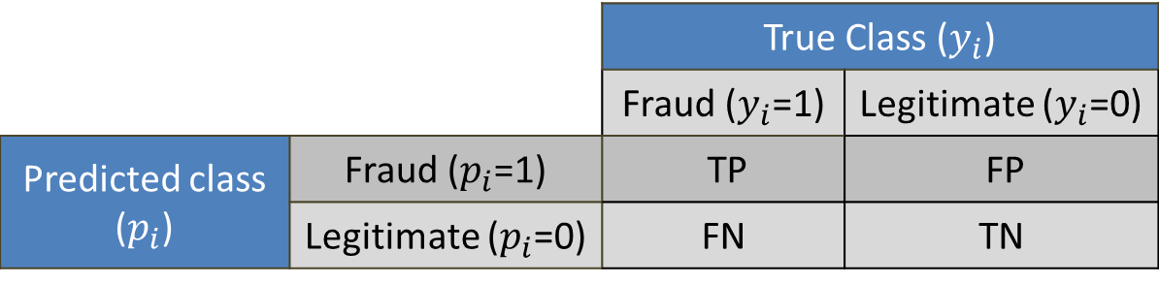

Evaluation
Misclassification $=1−\frac{TP+TN}{TP+TN+FP+FN}$
Recall $=\frac{TP}{TP+FN}$
Precision $=\frac{TP}{TP+FP}$
F-Score $=2\frac{Precision ∗ Recall}{Precision+Recall}$
 |  | True Class ($y_{i}$)
 |  | Fraud ($y_{i}$=1) | Legitimate ($y_{i}$=0)
Predicted class ($p_{i}$) | Fraud ($p_{i}$=1) | TP | FP
 | Legitimate ($p_{i}$=0) | FN | TN
Confusion matrix

Slide 10
Agenda
Introduction
Database
Evaluation of algorithms
Logistic Regression
Financial measure
Cost Sensitive Logistic Regression

Slide 11
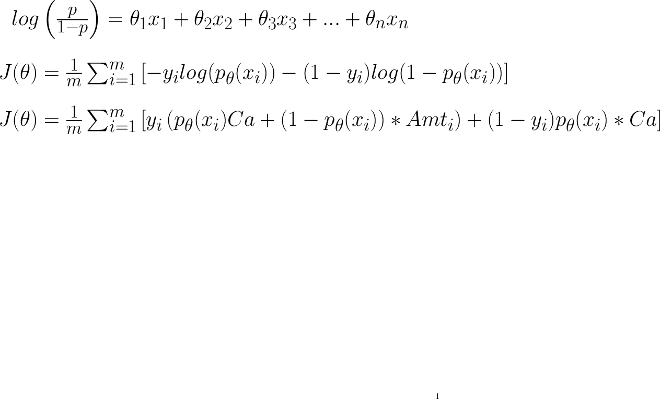
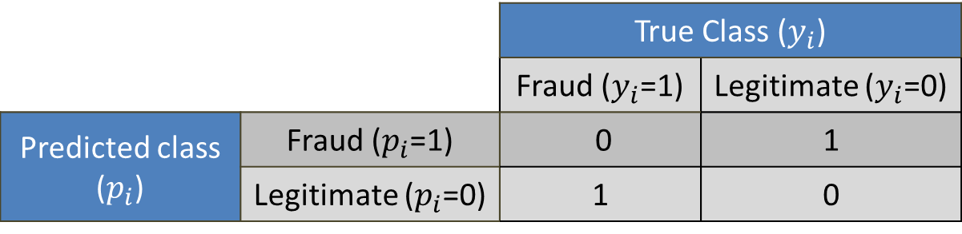
Logistic Regression
Model
Cost Function
Cost Matrix
 |  | True Class ($y_{i}$)
 |  | Fraud ($y_{i}$=1) | Legitimate ($y_{i}$=0)
Predicted class ($p_{i}$) | Fraud ($p_{i}$=1) | 0 | 1
 | Legitimate ($p_{i}$=0) | 1 | 0

Slide 12
Logistic Regression
Under sampling procedure
1% 5% 10% 20% 50%
0.467%
Select all the frauds and a random sample of the legitimate transactions.

Slide 13
Logistic Regression
Results

Slide 14
Financial evaluation
Motivation
False positives carry a different cost than false negatives
Frauds range from few to thousands of euros (dollars, pounds, etc)
There is a need for a real comparison measure

Slide 15
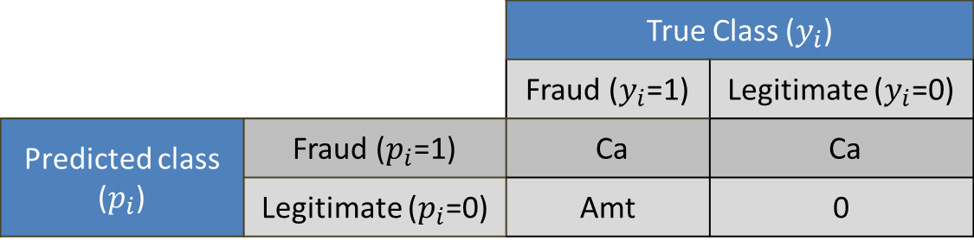
Financial evaluation
Cost matrix
where:
 |  | True Class ($y_{i}$)
 |  | Fraud ($y_{i}$=1) | Legitimate ($y_{i}$=0)
Predicted class ($p_{i}$) | Fraud ($p_{i}$=1) | Ca | Ca
 | Legitimate ($p_{i}$=0) | Amt | 0
Ca Administrative costs
Amt Amount of transaction i
Evaluation measure

Slide 16
Logistic Regression
Results
Selecting the algorithm by Cost
Selecting the algorithm by F1-Score

Slide 17
Logistic Regression
Best model selected using traditional F1-Score does not give the best results in terms of cost
Model selected by cost, is trained using less than 1% of the database, meaning there is a lot of information excluded
The algorithm is trained to minimize the miss-classification (approx.) but then is evaluated based on cost
Why not train the algorithm to minimize the cost instead?

Slide 18

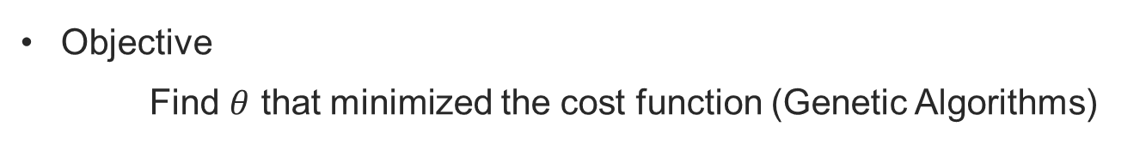
Cost Sensitive Logistic Regression
Cost Matrix
 |  | True Class ($y_{i}$)
 |  | Fraud ($y_{i}$=1) | Legitimate ($y_{i}$=0)
Predicted class ($p_{i}$) | Fraud ($p_{i}$=1) | Ca | Ca
 | Legitimate ($p_{i}$=0) | Amt | 0
Cost Function
Objective
Find $θ$ that minimized the cost function (Genetic Algorithms)

Slide 19
Cost sensitive Logistic Regression
Results

Slide 20
Cost sensitive Logistic Regression
Results

Slide 21
Conclusion
Selecting models based on traditional statistics does not give the best results in terms of cost
Models should be evaluated taking into account real financial costs of the application
Algorithms should be developed to incorporate those financial costs

Slide 22
Thank you!

Slide 23
Contact information
Alejandro Correa Bahnsen
University of Luxembourg
Luxembourg
al.bahnsen@gmail.com
http://www.linkedin.com/in/albahnsen
http://www.slideshare.net/albahnsen

